Slide 1
PROFESSIONAL ETHICS (HUT 200)
Module IV
RESPONSIBILITIES AND RIGHTS

Slide 2
Syllabus
Collegiality and loyalty – Managing conflict- Respect for authority- Collective bargaining- Confidentiality-Role of confidentiality in moral integrity-Conflicts of interest- Occupational crime- Professional rights-Employee right- IPR Discrimination.

Slide 3
Collegiality
Collegiality is the term that describes a work environment where responsibility and authority are shared among the colleagues.
It is a relationship between colleagues and is the tendency to support and cooperate with them.
Colleague is a fellow member of the same profession who are all united for a purpose.

Slide 4
Continued..
The main factors of collegiality
Respect: Results in support and cooperation with one’s colleagues.
Commitment: towards moral decisions, actions, goals of the organization, and values of the profession.
Connectedness: means shared commitment and mutual understanding

Slide 5
Loyalty
Loyalty is a devotion and faithfulness to a nation, cause, philosophy, country, group, or person.
Loyalty is the faithful adherence to an organization and the employer.
Loyalty to an employer can be either of the two types
Agency-loyalty − acting to fulfil one’s contractual duties to an employer.
Attitude-loyalty − has a lot to do with attitudes, emotions and a sense of personal identity as it does with actions.

Slide 6
Managing Conflict
Conflict - a “disagreement between two or more organisational members or groups arising from the fact they must share resources of work activities and/or from the fact that they have different status, goals, values or perceptions.”
In short, conflict refers to any kind of opposition or antagonistic intersection between two or more parties.
If it is managed correctly, it can be helpful (functional) in meeting the organisational goals.
If it is mishandled or not managed correctly, it can be destructive (dysfunctional).

Slide 7
Causes of Conflict
Problems in communication - (e.g., misunderstandings due to semantics, unfamiliar language, or ambiguous or incomplete information)
Personal relationships - (e.g., incompatibility of personal goals or social values of employees)
Organizational structure - (eg: power struggles between departments with conflicting objectives or reward systems)
Interdependence of two or more groups to achieve certain common goals.
Personality characteristics such as authoritarianism or dogmatism.

Slide 8
Methods for Managing Conflict
Collective Bargaining : Negotiations.
Conciliation : Series of conferences, including informal sitting between representatives of the two parties.
Mediation: Third party acts as a moderating influence on the two contending parties.
Arbitration: A third person is chosen as the Arbitrator by agreement between the employers and employees.

Slide 9
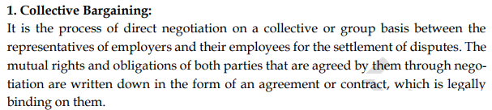
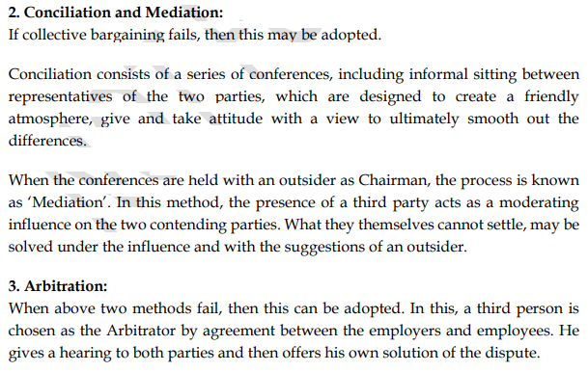

Slide 10
Conflict Management Process
Preliminary step — knowing the conflict.
The first stage in resolving the conflict is to know the full details of the conflict. As soon as the conflict comes to the knowledge of the senior or superior, he should handle the conflict skilfully.
Diagnosing the issue.
In diagnosing the issues, the issues involved in the conflict should be analysed and it should be understood what this conflict is about. Generally, conflict may arise due to facts, goals, methods, and values. The next thing in diagnosing the issue is to know why these differences between the two parties have arised.
Apply any Conflict Handling Modes
To avoid appearance of conflict
Not permitting conflict to surface
Mediation
Letting the parties in conflict to settle their scores
To solve the problems mutually

Slide 11
Respect for Authority
In order to meet the organizational goals, the professionals should possess respect for authority.
The levels of authority maintained by the organization provides a means for identifying areas of personal responsibility and accountability.
Types of Authority
Executive Authority − The corporate or institutional right given to a person to exercise power based on the resources of an organization.
Expert Authority − This is the possession of special knowledge, skill or competence to perform a particular task or to give sound advice.

Slide 12
Continue..
According to the goals of the company, the hierarchical authority is distributed.
Service oriented or engineer-oriented company concentrates on the quality of the products.
Customer-oriented company, focuses primarily on the satisfaction of the customers.

Slide 13
Collective Bargaining
The process of voluntary negotiations between the employers and a group of employees to resolve the conflicts is called Collective Bargaining.
The parties often refer to the result of the negotiation as a
Collective Bargaining Agreement (CBA) or as a
Collective Employment Agreement (CEA).
It is the responsibility of an organization to look into the welfare of the section of people working in it.
In order to deal with such complex situations, an Employee Union is formed wherein, each employee becomes a member and a leader is elected to represent the group whenever needed.

Slide 14
Objectives of Collective Bargaining
To increase mutual confidence between the employer and employees.
To regulate terms and conditions of employment without intervention of a third party.
To create cordial environment in the establishment.
To protect the interest of the employees; through collective action and by preventing unilateral action on the part of the employer.
To raise the socio-economic attributes of the employees.

Slide 15
Types of Collective Bargaining
Distributive Bargaining − In this, one party’s gain is another party’s loss. Example − Wages
Integrative Bargaining − In this, both the parties may gain or none of the parties may face a loss. Example − Better training programs
Attitudinal Structuring − When there is backlog of bitterness between both the parties then attitudinal structuring is required to make smooth industrial relations.
Intra-organizational Bargaining − There can be conflicting groups in both management and unions also. So, there is need to achieve consensus in these groups.

Slide 16
Process of Collective Bargaining
Identifying Bargaining Issues
Before going for negotiation, the issue and possible related areas for discussion are to be identified.
Preparing for Negotiations
Both the parties involved in collective bargaining should prepare before going for negotiation so that there can be proper negotiation at the time of discussion. The preparation would include the issue, parties involved, causes, costs and impacts
Negotiations Procedure
Negotiation procedure is the method of negotiation. It would show what activities are to be performed, who would perform and sequence and timing of the activities.
Reaching the Agreement - Negotiation completes with a mutually acceptable agreement.
Ratifying the Agreement – By Approving the agreement the issue of difference or conflict is over and negotiation comes to an end.
Administration of the Agreement - Once the agreement is accepted and signed, the agreement will be administered as per the terms and conditions of the agreement.

Slide 17
Advantages of Collective Bargaining:
Effective in Protecting and Promoting Interests of Workers
Control of Management’s Autocracy
Promotion of Durable Industrial Peace
Conducive to the Enhancement of Managerial Efficiency
Establishment of Industrial Rules and Creation of Labour Standards
Disadvantages of Collective Bargaining
Strikes
Based on Power and Conflict
Lacks Safeguards for Public Interest

Slide 18
Confidentiality
Confidentiality is that practice which helps to keep all information secret.
Important responsibility of an employee or an engineer is to maintain the confidentiality of the organization or the employer.
Moral principles justifying confidentiality
Respect for Autonomy
Respect for Promise
Trustworthiness
Respect for Public Welfare

Slide 19
Types of information under confidentiality
Privileged information : “available only on the basis of special privilege” such as a privilege accorded on an employee working on a special assignment.
Proprietary information : The information that a company owns or is the proprietor of, and hence is a term carefully defined by property law. It is simply called trade secret.

Slide 20
Conflicts of Interest
A conflict of interest occurs when the employee has more than one interest.
A professional conflict of interest is the situation where the professional has an interest that, if pursued, might prevent him from meeting his obligations to his employer or clients.
Eg: If a man works for a company, and is in some crucial position where he has access to all the confidential information and if he works as an unofficial adviser to his wife’s company, it would be morally wrong, where a moral conflict definitely arises. This can be termed as “Conflict in interests”.
Conflict of interest is different from conflicting interests.
Eg: a person has passion for music, sports apart from his regular job.

Slide 21
Types of Conflicts of Interest
Actual Conflict of Interest
Actual conflicts of interest arise when there is a direct conflict between a staff member's duties and responsibilities and their personal interests which influence the performance of those duties.
Apparent Conflict of Interest
Apparent conflicts of interest arise when there is a situation that gives the appearance of a conflict, even if there is no actual conflict present
Potential Conflict of Interest
Bribe and Gift
Moonlighting
Moonlighting usually refers to when a person holds a second job outside of normal working hours
Insider Information
The insider information might concern one’s own company or another company with which one does business. Leakage of the information for the interest of some other benefits is like digging one’s own pit

Slide 22
Occupational Crime
Occupational crimes are defined as offenses that are committed by someone during the course of his or her employment.
An occupational crime may be committed by
wrong actions of a person through one’s lawful employment or
crime by an employee to promote ones own or employer’s interest or
theft or pilferage by the employee or
damage to the property of an employee of one’s organization.
Also known as white-collared crimes.

Slide 23
Common examples
Embezzlement - theft or misappropriation of funds placed in one's trust or belonging to one's employer.
Altering company records without authorization
Committing tax fraud
Money laundering
Misusing company data or property
Committing stock and securities violations
Racketeering
Racketeering is a set of illegal activities aimed at commercial profit that may be disguised as legitimate business deals. Racketeering is defined by a coordinated effort by multiple people to repeatedly earn a profit.

Slide 24
Categories of Occupational Crimes
Crimes of trust, or property crimes that involve deliberate contact with at least one victim or an attempt to conceal the fact that a crime has been committed;
Offenses that were committed in the course of employment, such as accepting bribes;
Crimes committed in furtherance of business operations, but not operations that are central to business purposes, such as misrepresentation in advertising; and
Offenses in which crime is the central activity of the business, such as real estate fraud.

Slide 25
Professional Rights
The basic rights of engineers as other employees, include
the right to live freely and pursue their legitimate interests as any human being,
the right to be against racial or sexual discrimination,
receiving one’s salary according to the work,
choosing of political activities, etc.,

Slide 26
Continued..
The rights that engineers have as professionals are called Professional Rights. These professional rights includes:
The basic right of professional conscience: Moral right to exercise professional judgment in pursuing professional responsibilities.
The right of conscientious refusal: Right to refuse to engage in unethical behavior
The right of professional recognition: Right to the recognition of one’s work and accomplishments.

Slide 27
Employee Rights
The moral and legal rights that are obtained by the status of being an employee.
Basic human Rights
Professional Rights
Institutional / Contractual Rights
Non- Contractual Employee Rights

Slide 28
Professional rights
The rights that engineers have as professionals are called Professional Rights. These professional rights includes:
1) The basic right of professional conscience: Moral right to exercise professional judgment in pursuing professional responsibilities.
2.) The right of conscientious refusal: Right to refuse to engage in unethical behavior
3.) The right of professional recognition:
Right to the recognition of one’s work and accomplishments.
4. Right to warn the public about dangers.

Slide 29
Human Rights
1. Right to pursue legitimate personal interest
2. Right to make a living
3. Right to privacy
4. Right to property
5. Right of non-discrimination
6. No sexual harassment

Slide 30
Institutional / Contractual Employee Rights
Right to receive specified salary
Increments
Benefits

Slide 31
Non- Contractual Employee Rights
Right to Privacy
right of having a private life
Right to Equal Opportunity—Non-discrimination
Equal Opportunity – Sexual Harassment
Equal opportunity – Affirmative Action
Affirmative action – preference given to a person or a group who was denied equal importance in the past .

Slide 32
Intellectual property rights
Intellectual property right is a type of property right which allows the creators or owners of patents trademarks or copyrighted works to benefit from their own work or investment.
The global IPR system strengthens protection, increases the incentives for innovation, and raises returns on international technology transfer.

Slide 33
Protection of IPR / Why IPR ?
IPR protection stimulates creativity, research, and innovation by ensuring freedom to individuals and organizations to benefit from their creative intellectual investments.
The IP serves many purposes, namely
It prevents others using it,
Prevent using it for financial gain,
Prevent plagiarism
Provides a strategy to generate steady income etc,.

Slide 34
Types of Protection
1. Patents
A Patent is an exclusive right granted for an invention. It provides the patent owners with protection generally for a period of 20years.
Once the patent protection is granted, that invention cannot be commercially made, used, distributed or sold without the patent owner’s consent.
Courts provide the legal safety for these patent rights.

Slide 35
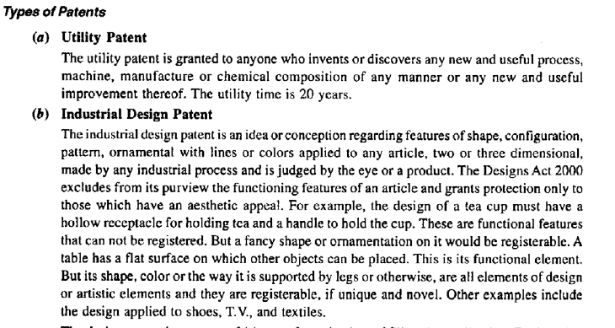
Types of patents

Slide 36
2. Trademarks
It means certain distinctive marks or signs that identifies certain goods or services produced or provided by an individual or a company.
The protection offered through the trademarks is limited for a period, but can be renewed indefinitely upon payment of the corresponding fee.

Slide 37
3. Copyright
The copyright is a specific and exclusive right, describing rights given to creators for their literary and artistic works. E.g software, multimedia, paintings, sculptures Etc.,
Copyright is effective in
(a) preventing others from copying or reproducing or storing the work,
(b) publishing and selling the copies
(c) performing the work in public, commercially
(d) to make film
(e) to make translation of the work,
(f) to make any adaptation of the work.

Slide 38
4. Trade Secret
A trade secret is the information which is kept confidential as a secret.
This information is not accessed by the any other (competitor) than the owner.
The trade secrets may be formulae, methods, programs, process, test results, data collected, analyzed, synthesized etc.,

Slide 39
5. Industrial designs
Ownership of industrial designs protect it from duplication .
Industrial Design (ID) is the professional practice of designing products, devices, objects and services used by millions of people around the world every day.

Slide 40
6. Geographical Area indication
Helpful for the customers to identify the orginal and quality products which are produced using the raw materials of that geographical area.
Examples : Brazil for coffee beans

Slide 41
. Advantages of Intellectual Property Rights
Intellectual property rights are advantageous in the following ways −
Provides exclusive rights to the creators or inventors.
Encourages individuals to distribute and share information and data instead of keeping it confidential.
Provides legal defense and offers the creators the incentive of their work.
Helps in social and financial development.

Slide 42
UNIVERSITY QUESTIONS
1. Define collegiality and loyalty.(3)
2. What are the two senses of Loyalty? (3)
3. What are Conflicts of Interests? (3)
4. What is confidentiality and why is it needed. (3)
5. Differentiate between Patents and Trademarks.(3)
6. Describe the major steps involved in the process of collective bargaining. (7)
7. Explain the different steps in managing conflicts in an organization. (7)
8. Exemplify conflicts of interest and conflicts in interest.(6)
9. Illustrate various rights of an engineer as a professional. (8)
10. Discuss the methods to improve collegiality and loyalty. (7)

Slide 43
11. Explain collective bargaining. (7)
12. What are occupational crimes? Give examples (8)
13. How conflicts can be managed in a workplace? (6)
14. What are intellectual property rights? Explain the elements of intellectual property rights in details and benefits of IPR. (7)
15. What is meant by ‘whistle blowing’? List four aspects of ‘whistle blowing’ (7)
16. Discuss in detail about the employee Rights and its role in the organizations. (7)
17. What does the term collective bargaining refer to? Explain. (7)

